Slide 1
Data Model mapping to SDT Example Echonet
Andreas Sayegh, Deutsche Telekom
HGI Q4/2014, Paris
Intended for: SHTF
Document No. HGIxxxx

Slide 2
Purpose of this contribution
Propose the concept of data points to the SDT
Show some Echonet examples that could make use of the data point concepts
Show how a generic sensor model in Echonet could look like using SDT

Slide 3

Using current SDT entities to model data points
Document
Actions
Named operation
Parameter(s)
Return value(s)
Events
Named notification
Payload
It’s possible to model a data model using actions…
Get/set actions pattern for each data point (see example)
However, for appliances with numerous data points this method could easily result in rather bloated XML documents
Moreover, it makes it hard for transformation engines (e.g. for TR-069) to reengineer data points if needed by target technology
<ModuleClass name="BooleanState">
<Actions>
<Action name="getStatus" type="boolean”> </Action>
<Action name="setStatus">
<Arg name="value" type="boolean"> </Arg>
</Action>
</Actions>
</ModuleClass>

Slide 4
A <DataPoint> tag could slim down modeling
Document
Easy modeling of data model based technologies (e.g. Echonet)
Only 1 entry per data point
Transformations to APIs can still use object oriented approach
No reverse engineering of data points for data model driven target systems
Con: Different options to model data points needs more work in clearing process
<ModuleClass name="BooleanState">
<Data>
<DataPoint name=“status” type=“boolean”
writable=“true”>
</DataPoint>
</Data>
</ModuleClass>

Slide 5
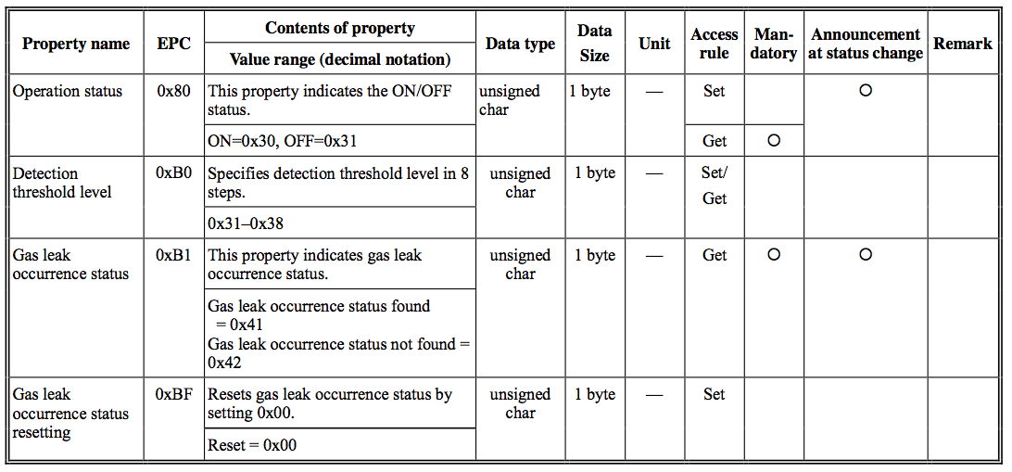
Examples from Echonet (1/3) Gas Leak Sensor
Source: http://www.echonet.gr.jp/english/spec/pdf_spec_app_e_e/SpecAppendixE_e.pdf

Slide 6
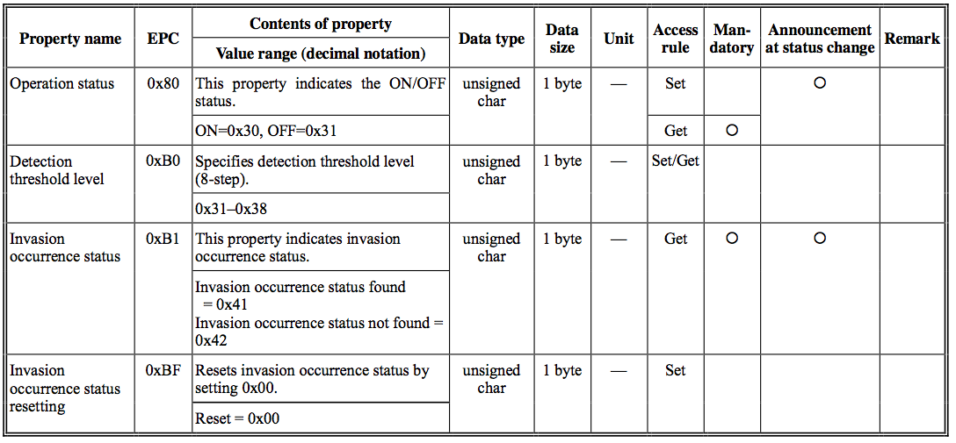
Examples from Echonet (2/3) Invasion Sensor
Source: http://www.echonet.gr.jp/english/spec/pdf_spec_app_e_e/SpecAppendixE_e.pdf

Slide 7
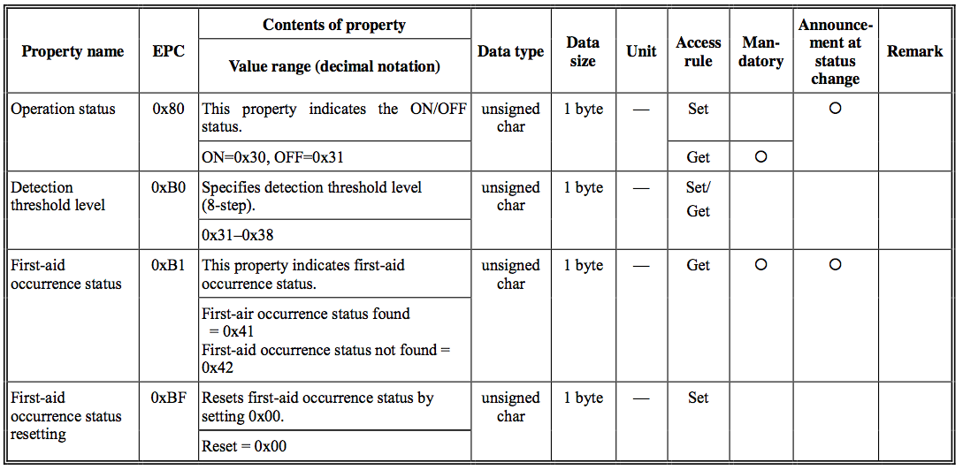
Examples from Echonet (3/3) First Aid Sensor
Source: http://www.echonet.gr.jp/english/spec/pdf_spec_app_e_e/SpecAppendixE_e.pdf

Slide 8
Echonet examples - conclusions
Echonet is plain data model driven, interfaces only allow for reading/writing values
All shown sensors have the exactly same interface
Only difference is the meaning of the sensor values (“semantics”)
Hence, it’s probably a good idea to generalize the functions into a SDT ModuleClass

Slide 9
How could these examples look like in SDT?
Definition of a ModuleClass “Sensor” in the domain of Echonet
The description shows 3 data points and 1 action (reset)
The “reset” action also shows the flaw of a plain data driven modeling: it requires to send a useless parameter
Since these are sensors, the status itself is not modifiable by the application
Concrete sensors can be specified by SDT Modules using this extending this ModuleClass
Document
<Domain name=“jp.gr.echonet”>
<ModuleClass name=”Sensor">
<Data>
<DataPoint name=“operationStatus” type=“boolean” writable=“true” />
<DataPoint name=“detectionThresholdLevel” type=“integer” writable=“true” />
<DataPoint name=“status” type=“boolean” />
</Data>
<Actions>
<Action name=”reset” /> </Actions>
</ModuleClass>
</Domain>

Slide 10
Requested action
Approve data model option as part of the SDT
Call for contribution on how to express data models in the SDT

Slide 11
Thank You! Andreas.sayegh@telekom.de

